Slide 1

Sheet pile
Kratos and probabilistic library
Naam Achternaam

Slide 2
Overview
Sheet pile model, stages
Linear model:
  Variables
  Uncertainty analysis (max displacement x)
  Uncertainty analysis (max bending moment)
Mohr-Coulomb model:
  Variables
  Uncertainty analysis (max displacement x)
  Uncertainty analysis (max bending moment)

Slide 3
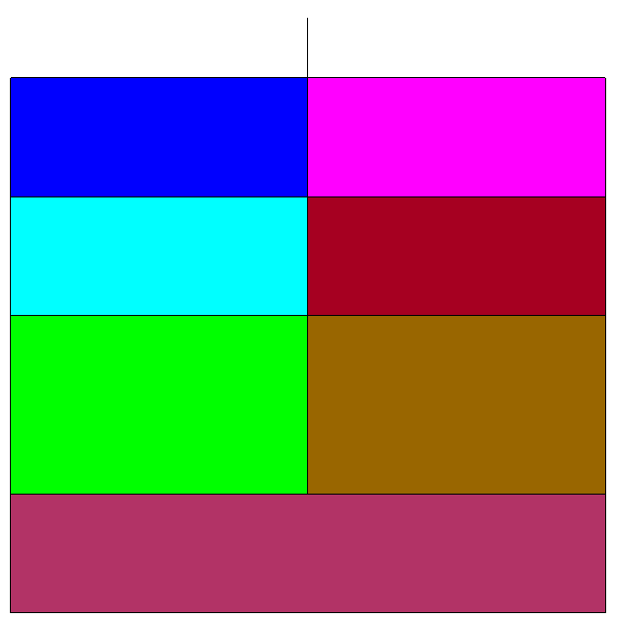
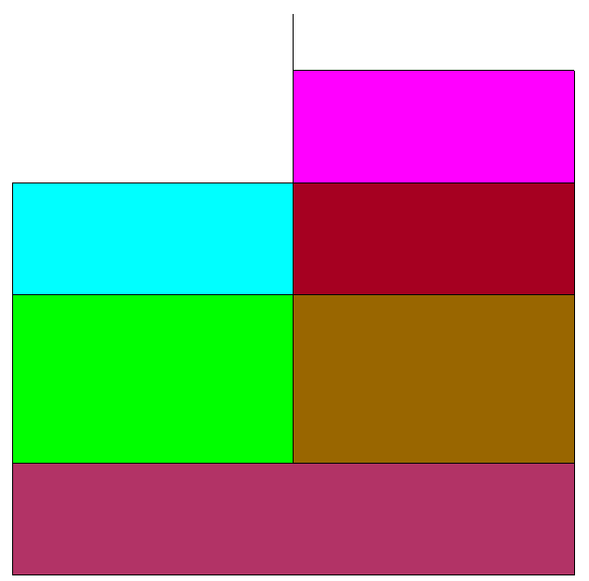

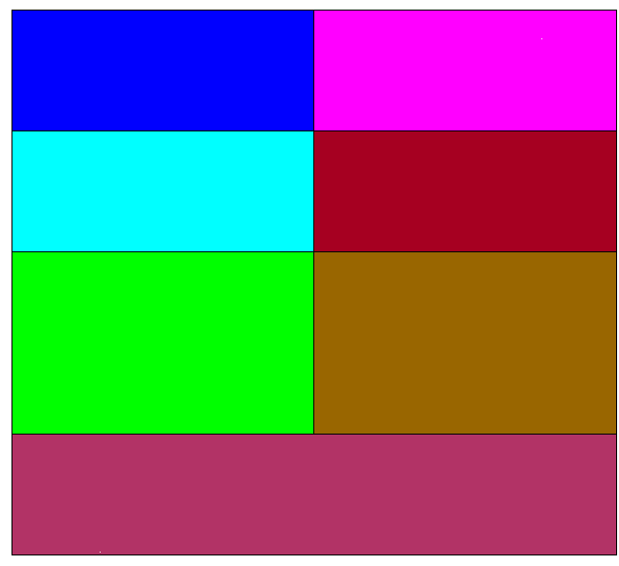
Sheet pile model, stages
Stage 0
Stage 1
Stage 2
Stage 3
Caly (1)
Clay (1)
Caly (2)
Clay (2)
Sand (3)
Sand (3)
Sand (3)
sand
sand
sand

Slide 4
Lineair model

Slide 5
Variables
Input:
Variable | Distribution type | Parameters
Young modulus (clay) | Uniform | 5x10**6 – 8x10**6
Young modulus (sand) | Uniform | 30x10**6 – 50x10**6
Interface stiffness | Deterministic | 10**11
Sheet pile: Young modulus | Deterministic | 200x10**9
Sheet pile: Poisson ratio | Deterministic | 0
Sheet pile: thickness | Deterministic | 0.02159
Output: total displacement x (maaiveld node), max bending moment

Slide 6
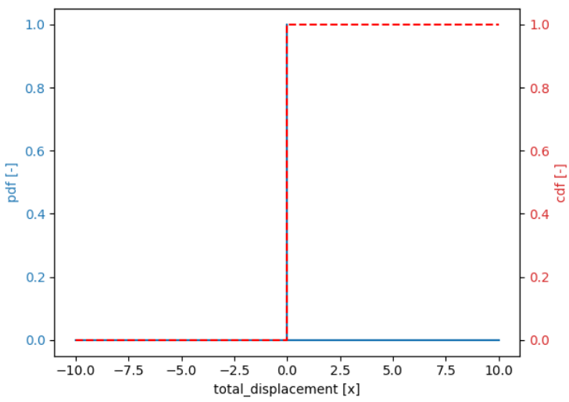
Uncertainty analysis (total displacement x)
Stage 0 (no sheet pile)
Monte Carlo, 50 – 100 samples

Slide 7
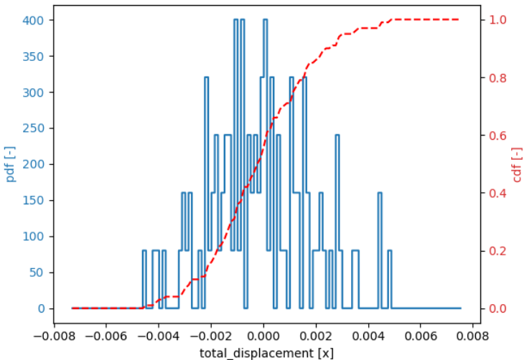
Uncertainty analysis (total displacement x)
Stage 1 (with sheet pile)
Monte Carlo, 50 – 100 samples

Slide 8
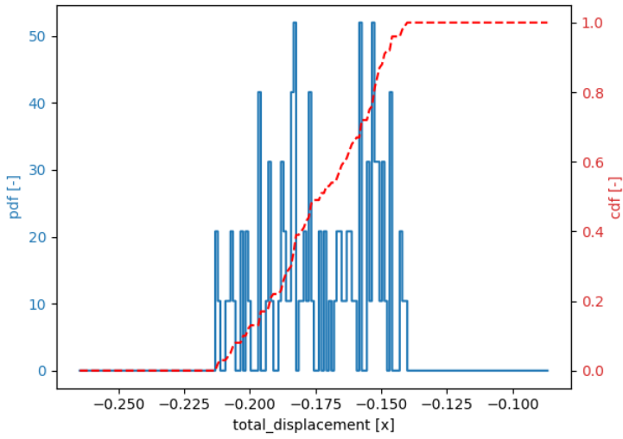
Uncertainty analysis (total displacement x)
Stage 2 (excavation, no anker)
Monte Carlo, 50 – 100 samples

Slide 9
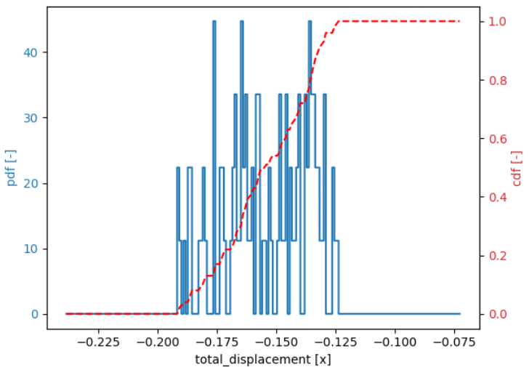
Uncertainty analysis (total displacement x)
Stage 3 (excavation, with anker)
Monte Carlo, 50 – 100 samples

Slide 10
Uncertainty analysis (max bending moment)
Stage 0 (no sheet pile)
Monte Carlo, 50 – 100 samples
No results returned, but there was no sheet pile

Slide 11
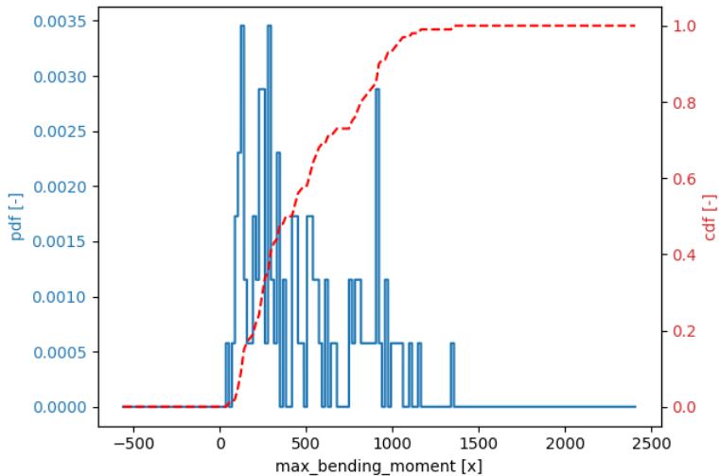
Uncertainty analysis (max bending moment)
Stage 1 (with sheet pile)
Monte Carlo, 50 – 100 samples

Slide 12
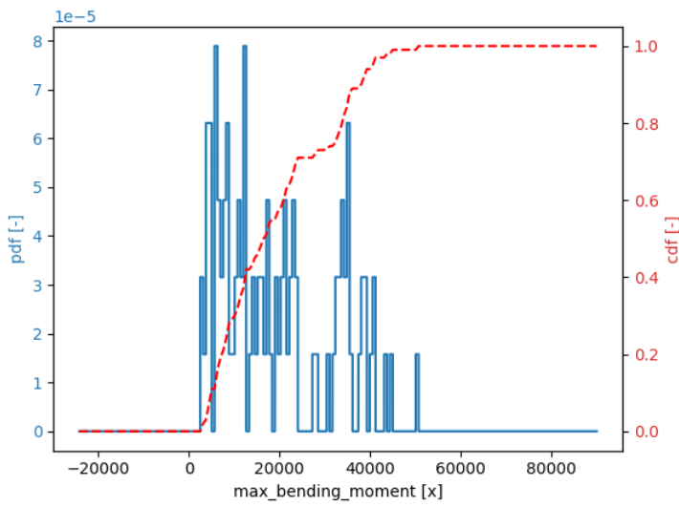
Uncertainty analysis (max bending moment)
Stage 2 (excavation, no anker)
Monte Carlo, 50 – 100 samples

Slide 13
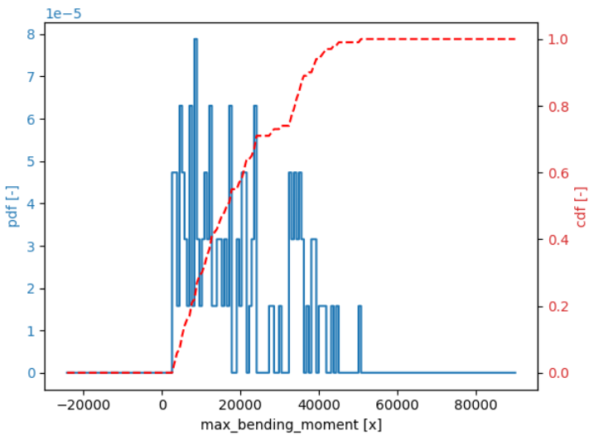
Uncertainty analysis (max bending moment)
Stage 3 (excavation, with anker)
Monte Carlo, 50 – 100 samples

Slide 14
Mohr-Coulomb model

Slide 15
Variables
Input:
Variable | Distribution type | Parameters
Cohesion | Log-normal | Mu = 3, CoV = 0.2
Friction angle (clay) | Log-normal | Mu = 22.5, CoV = 0.08
Friction angle (sand) | Log-normal | Mu = 32.5, CoV = 0.08
Young modulus (clay) | Uniform | 5x10**6 – 8x10**6
Young modulus (sand) | Uniform | 30x10**6 – 50x10**6
Sheet pile: Young modulus | Deterministic | 200x10**9
Sheet pile: Poisson ratio | Deterministic | 0
Sheet pile: thickness | Deterministic | 0.02159
Interfaces (cohesion, friction angle) | The same as soil | The same as soil
Output: total displacement x (maaiveld node), max bending moment

Slide 16
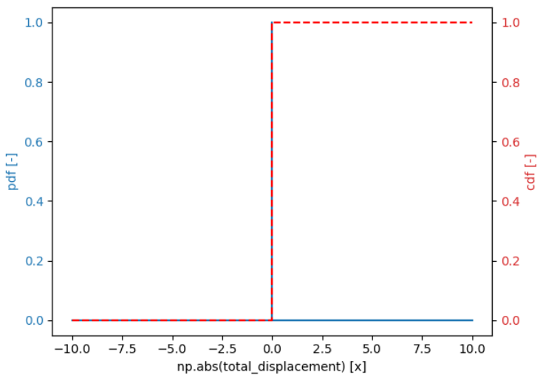
Uncertainty analysis (max total displacement)
Stage 0 (no sheet pile)
Stage 1 (with sheet pile)
Stage 2 (excavation, no anker)
Monte Carlo, 10 - 50 samples

Slide 17
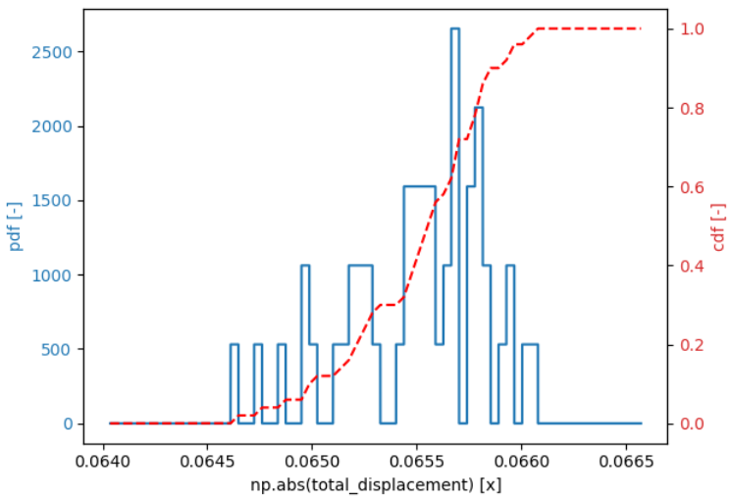
Uncertainty analysis (max total displacement)
Stage 3 (excavation, with anker)
Monte Carlo, 10 - 50 samples

Slide 18
Uncertainty analysis (max bending moment)
Stage 0 (no sheet pile)
Monte Carlo, 10 – 50 samples
No results returned, but there was no sheet pile

Slide 19
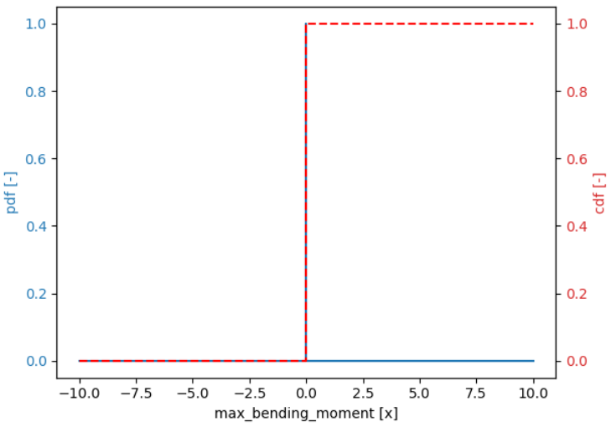
Uncertainty analysis (max bending moment)
Stage 1 (with sheet pile)
Monte Carlo, 10 – 50 samples

Slide 20
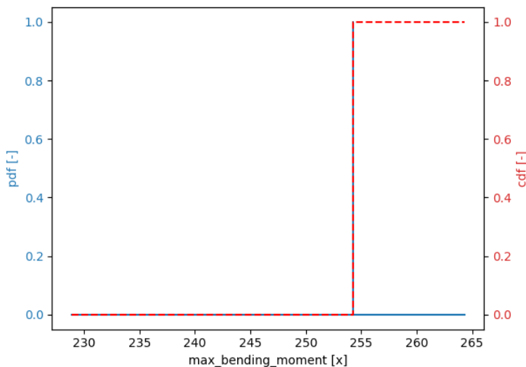
Uncertainty analysis (max bending moment)
Stage 2 (excavation, no anker)
Monte Carlo, 10 – 50 samples

Slide 21
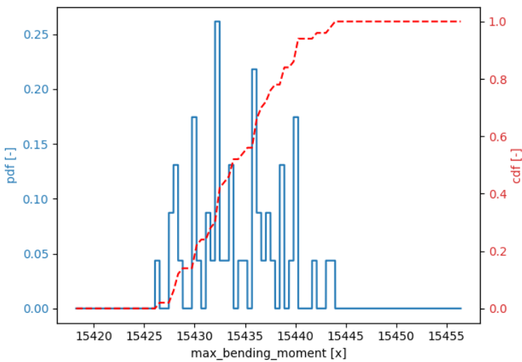
Uncertainty analysis (max bending moment)
Stage 3 (excavation, with anker)
Monte Carlo, 10 – 50 samples

Slide 22
Summary

Slide 23
Verbeterpunten
Lineair model:
  Interfaces aanpassen in het lineair model (normal, 10**11)
  Klei: Volume gewicht + young modulus
  Totale displacement, op het maaiveld ter plaatse van de damwand (met teken) → maaiveld node 171
  Onder + 2 net boven → zand
  Correlatie
Mohr-Coloumb:
  Klei: Volume gewicht + young modulus
  Totale displacement, op het maaiveld ter plaatse van de damwand (met teken) → maaiveld node 171
  Onder + 2 net boven → zand
  Interfaces: net als bij grond
  Correlatie

